Slide 1
Unit 1
Similarity, Congruence, & Proofs

Slide 2
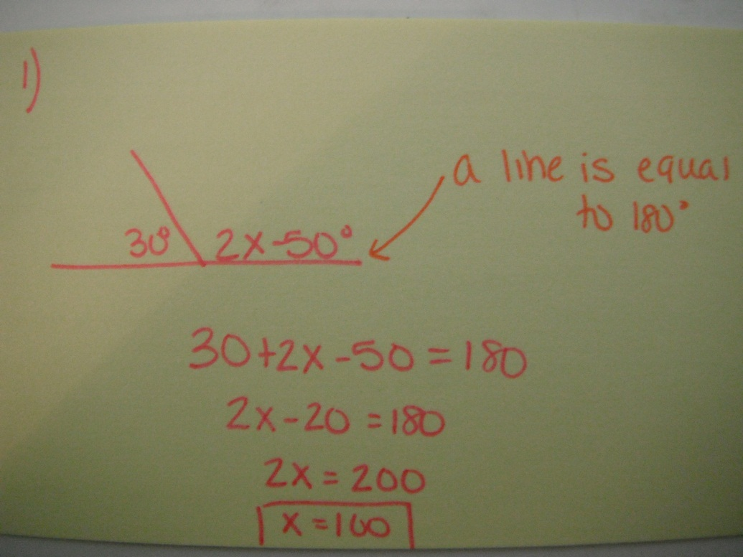

1. Solve for x.
30°
2x – 50°

Slide 3
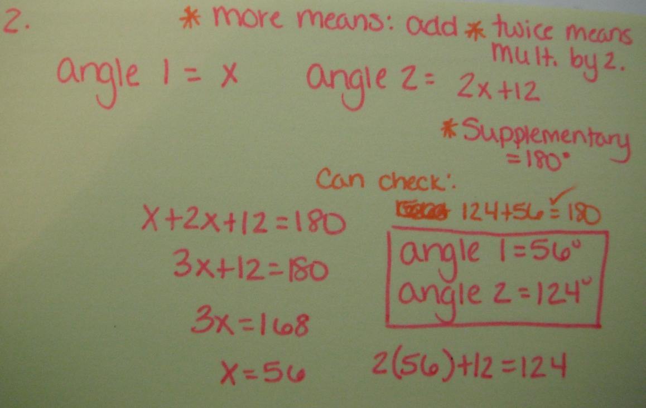
2. Solve the following.
One angle is 12 more than twice its supplement. Find both angles.

Slide 4
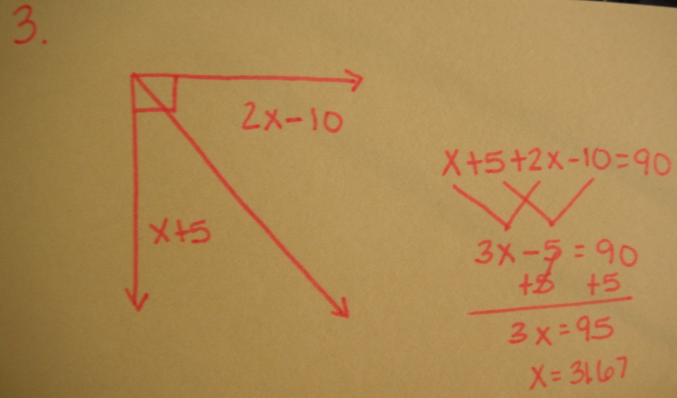
3. Solve for x.
2x - 10
x + 5

Slide 5
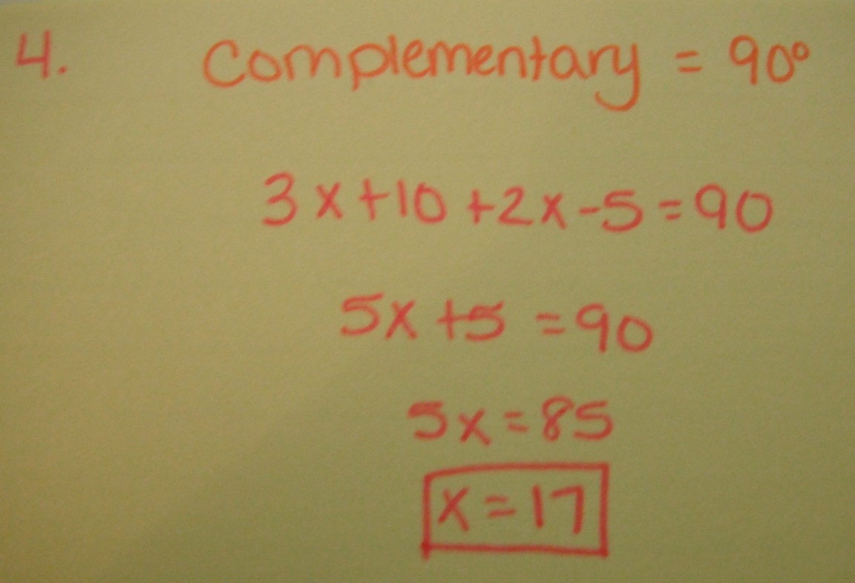
4. Solve for x.
3x + 10° and 2x – 5° are complementary.

Slide 6
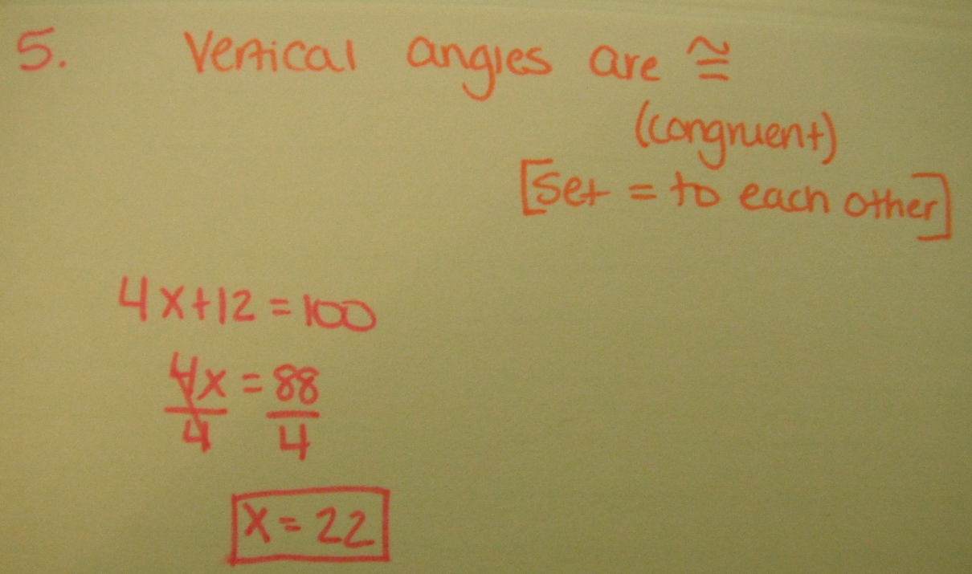
5. Solve for x.
4x + 12
100°

Slide 7
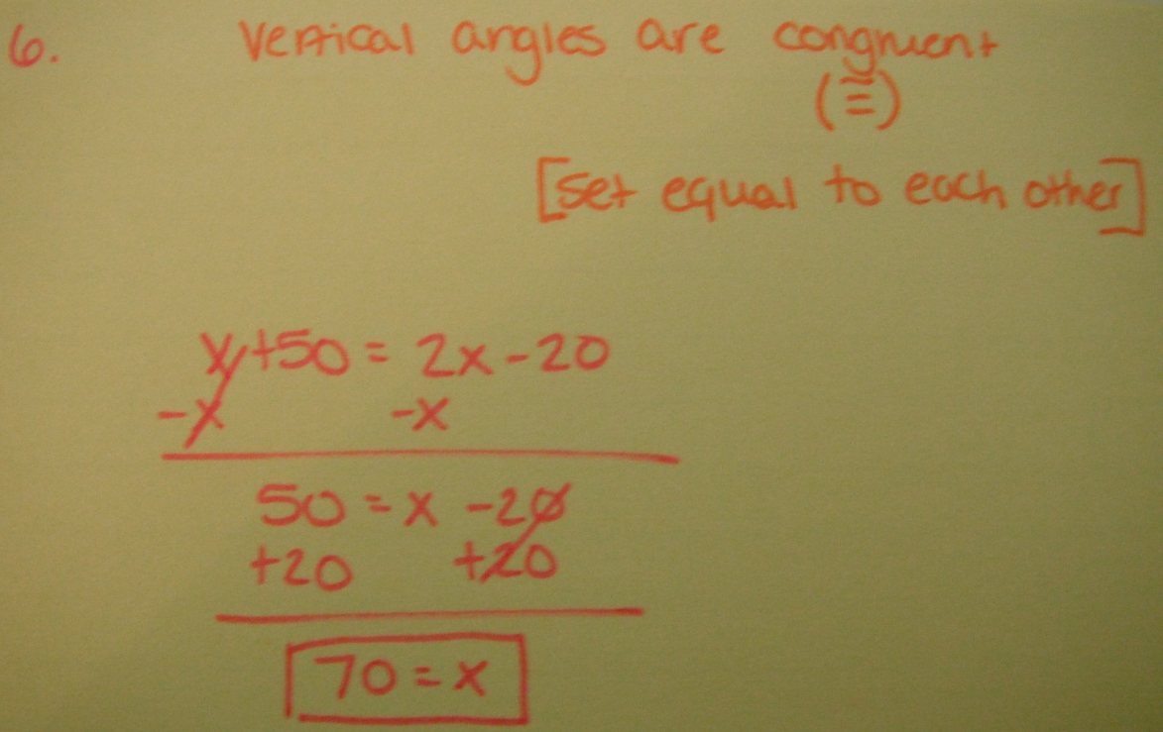
6. Solve for x.
x + 50
2x - 20

Slide 8
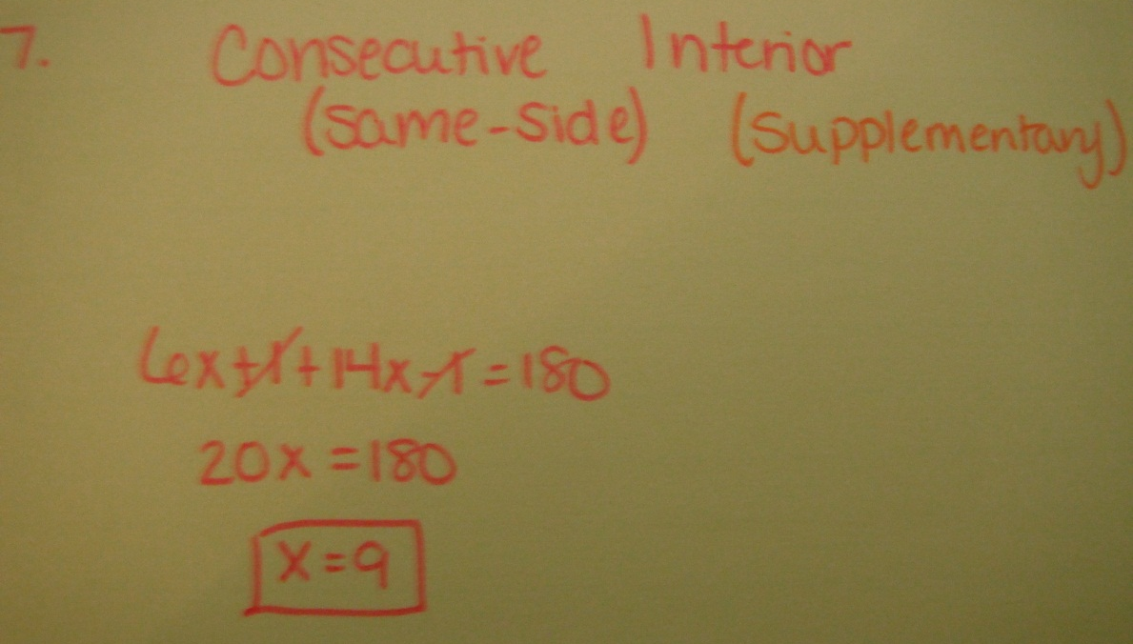
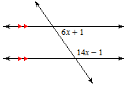
7. Solve for x.

Slide 9
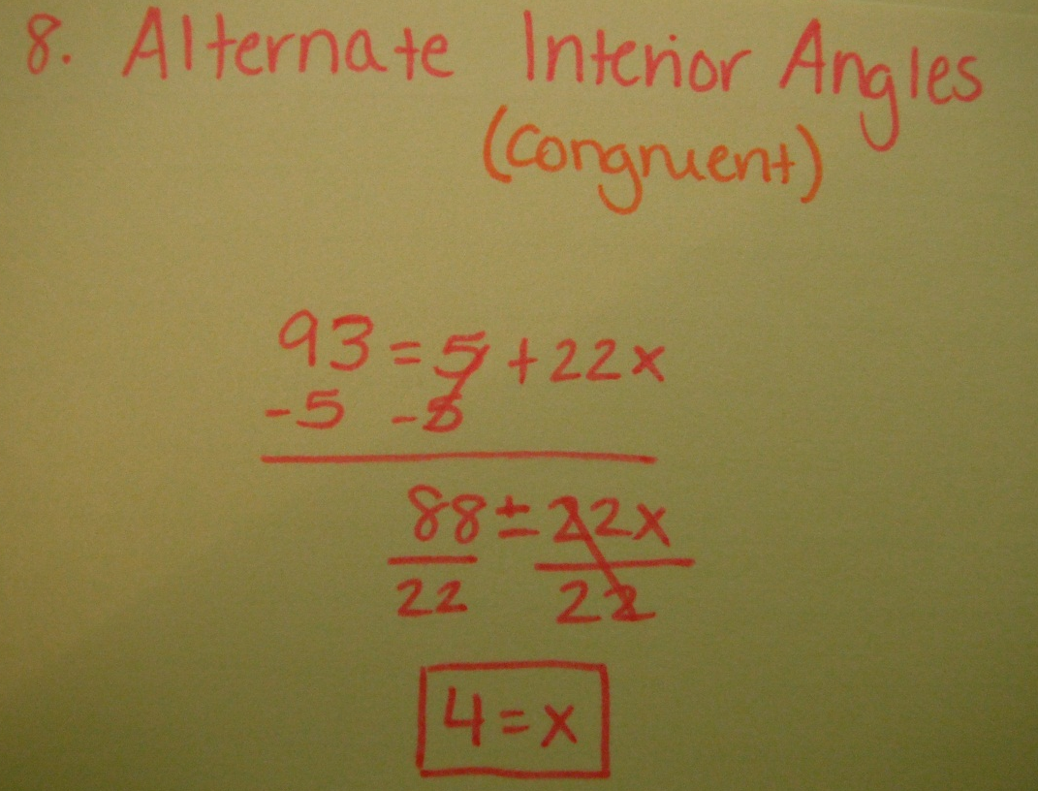
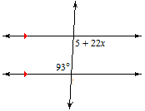
8. Solve for x.

Slide 10
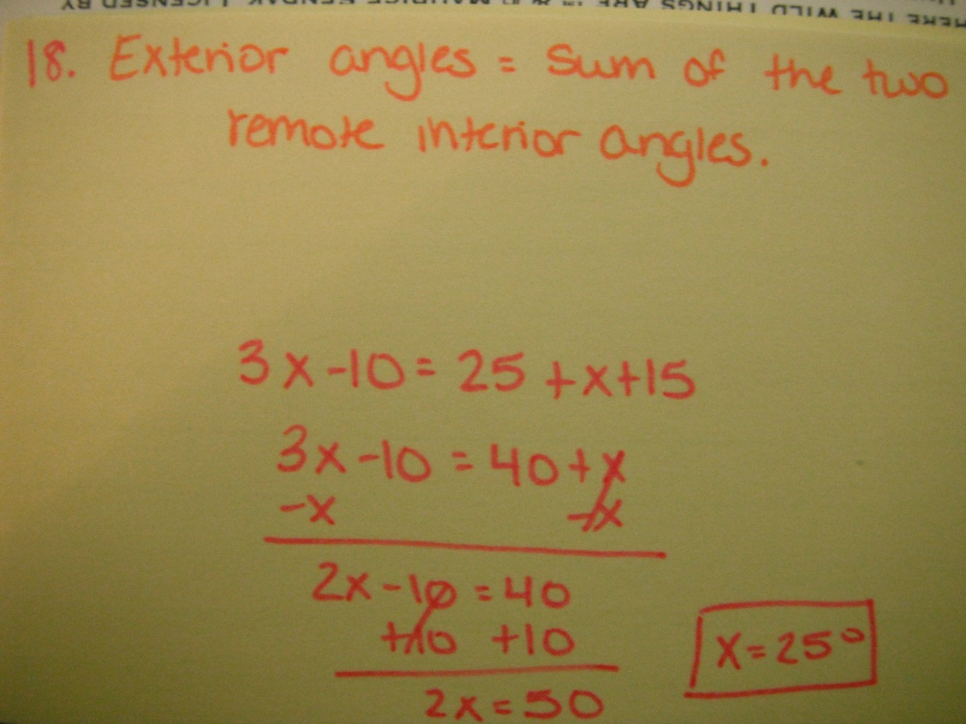
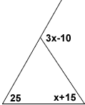
18. Solve for x.

Slide 11
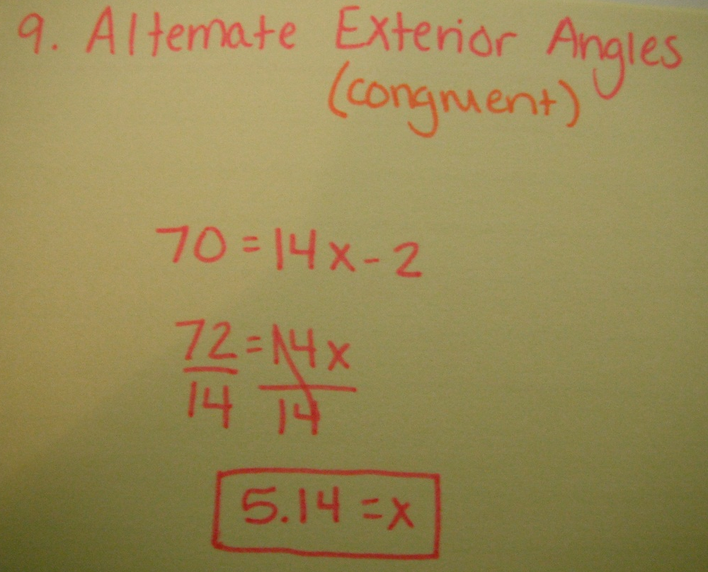
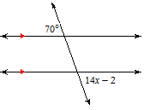
9. Solve for x.

Slide 12
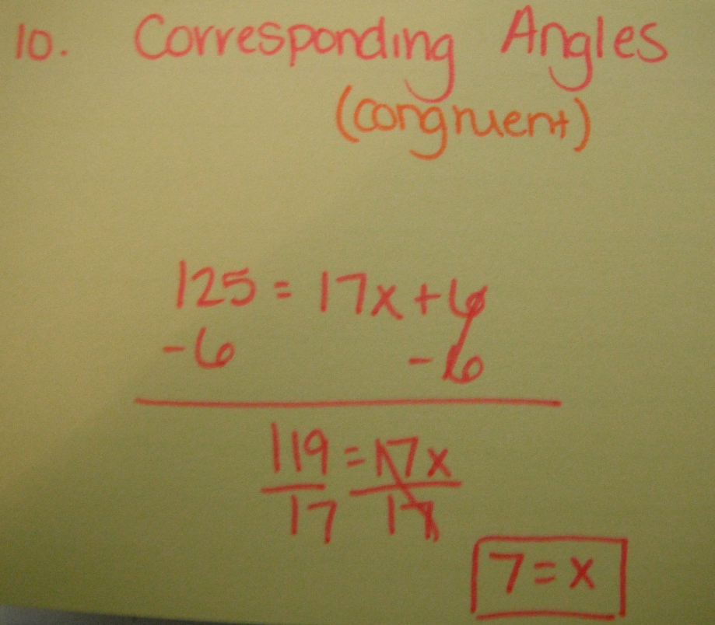
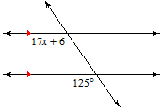
10. Solve for x.

Slide 13
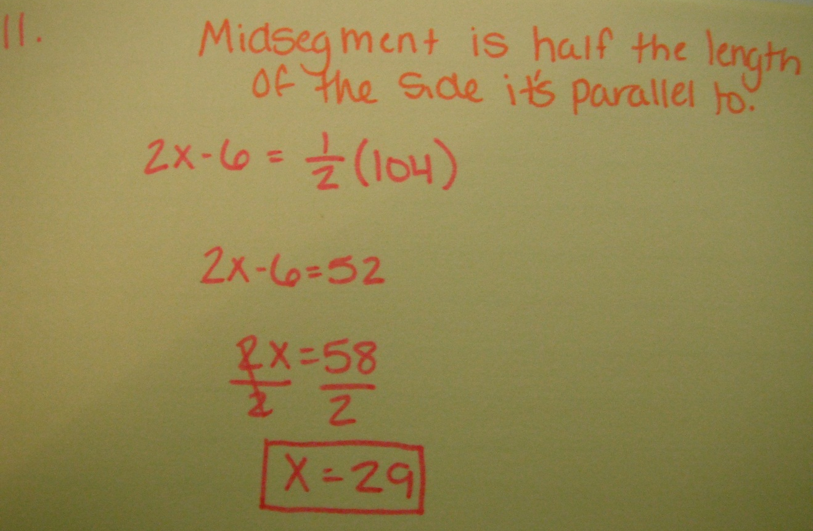
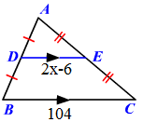
11. Solve for x.

